Slide 1

OPENSTACK INSTALLER
Internal Guide : Prof. R.A.Patankar
External Guide : Mr. Shekhar Londhe
Project Sponsored By
Presented By
Mrunal Bokil (B80024216)
Anjani Mantri (B80024233)
Ketan Bongirwar (B80024222)
Kaustubh Dhokte (B80024316)

Slide 2
Agenda
Introduction
Problem Statement
Literature Survey
System Overview
Modular Flow
Installation Procedures
About Puppet (CM tool)
System Requirements
Future Scope
References

Slide 3
The Current Scenario
INTRODUCTION
Cloud Computing : Increasing popularity and demand.
Interest of organisations in setting up their own clouds. (Eg.: Educational Institutes, Banks)

Slide 4

Major Cloud Service Providers
INTRODUCTION

Slide 5
Problem Statement
To come up with an installer which automates the installation of openstack (Grizzly release) services and allows the user to easily configure them on Ubuntu 12.04 (LTS) .

Slide 6
Literature Survey
Cloud Computing
Infrastructure As a Service (IAAS)
Software As a Service (SAAS)
Platform As a Service (PAAS)

Slide 7
What is OpenStack ?
OpenStack - An Open source Software for building private and public clouds.
Open Source = Free + Flexible
Predominantly acting as an infrastructure as a service (IaaS) platform
Controls large pools of compute, storage, and networking resources, all managed through a dashboard
Used in about 132 countries and has a global community of technologists, developers, researchers, corporations and cloud computing experts.

Slide 8
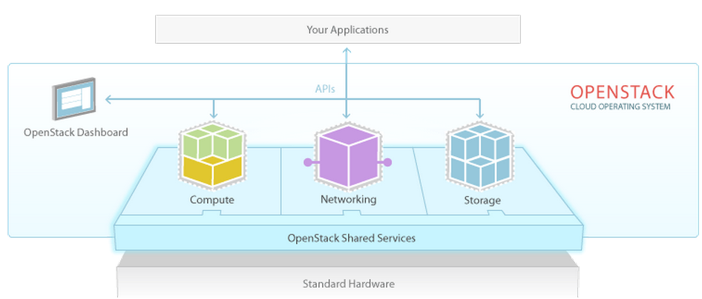
Literature Survey
Openstack Services
Compute (Nova)
Block Storage (Cinder)
Networking (Quantum)
Dashboard (Horizon)
Identity Service (Keystone)
Image Service (Glance)
Openstack Applications

Slide 9
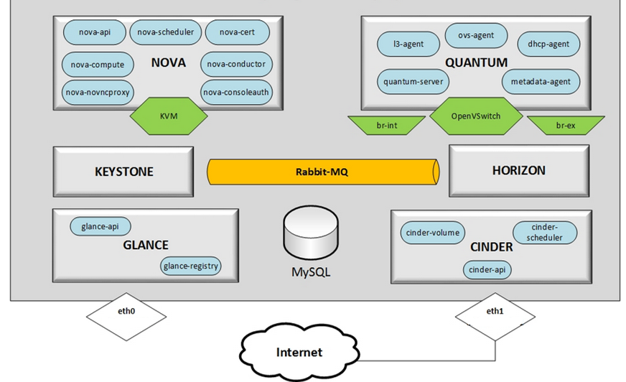
System Overview

Slide 10
Current Installation Procedure
Multiple manual steps
Exposure of end-user to unix/linux OS
Requires thorough knowledge of linux commands

Slide 11
Modular Flow
Ext. Host IP
Host IP
Install Keystone Service
Install Glance Service
Install Cinder
Get Input
Credentials
Install Horizon Service
Install Quantum
Install Nova Service

Slide 12
Installation Procedures

Slide 13
Keystone (Identity service)
Install keystone packages
Create and configure mysql database for keystone
Update configuration files and restart services
Synchronise database
Create tenants, roles and users
Assign proper roles to users
Create services and service endpoints

Slide 14
Glance (Image Service)
Install glance packages
Create and configure mysql database for glance
Update configuration files and restart services
Synchronise database

Slide 15
Cinder (Block storage)
Install cinder packages
Configure iSCSI services
Create and configure mysql database
Update configuration files
Synchronise database
Restart the services
Take care that the loop file remains associated with loop device after reboot
Initialize it as a lvm physical volume and create a lvm volume group
Create a test loop file and associate it with a loop device

Slide 16
Nova (Compute service)
Install and configure the hypervisor (KVM)
Install nova packages
Create and configure mysql database for nova
Update configuration files and restart services
Synchronise database

Slide 17
Quantum (Networking)
Install and configure the OpenVSwitch and create bridges
Install quantum packages
Create and configure mysql database for quantum
Update configuration files and restart services
Synchronise database

Slide 18
Horizon (Dashboard)
Install horizon packages
Restart services

Slide 19
About Puppet
An open source configuration management tool from Puppet Labs under Apache 2.0 licence
Latest version Puppet 3.4.2
Written in Ruby
Supports almost all linux distributions
Widely used
Active community
Uses a custom declarative language to describe system resources and their state

Slide 20
System Requirements
For OpenStack Services :
Minimum 8GB RAM
500+ GB Hard Disk
Support to the Intel® 64 or AMD64 CPU extensions, and the AMD-V™ or Intel VT® hardware virtualization extensions.
For OpenStack Installation:
Linux OS Ubuntu 12.04
Puppet(Automation tool)

Slide 21
Future Scope
Installer for other linux platforms
Installer for further releases of OpenStack

Slide 22
Conclusion
We could successfully develop an installer which automates the installation of openstack (Grizzly release) services and allows the user to easily configure them on Ubuntu 12.04 (LTS) .

Slide 23
References
[1] Wuhib, Stadler, Lindgren,“Dynamic resource allocation with management objectives—Implementation for an OpenStack cloud”,Network and service management (cnsm), 2012 8th international conference and 2012 workshop on systems virtualiztion management (svm).
[2] Sharma, P. ; Chatterjee, S. ; Sharma D, “CloudView: Enabling tenants to monitor and control their cloud instantiations”, Integrated Network Management (IM 2013), 2013 IFIP/IEEE International Symposium.
[3] Khan,Ylitalo, AhmedA.S.,“OpenID authentication as a service in OpenStack”,Information Assurance and Security (IAS), 2011 7th International Conference Digital Object.
[4] Tamura,Yoshinobu,Yamada,Shigeru,“Service-Oriented Maintainability Modeling and Analysis for a Cloud Computing”,Computer Software and Applications Conference Workshops (COMPSACW), 2013 IEEE 37th Annual.
[5] http://docs.openstack.org/havana/install-guide/install/apt/content/
[6] http://www.openstack.org/

Slide 24
THANK YOU

Slide 25
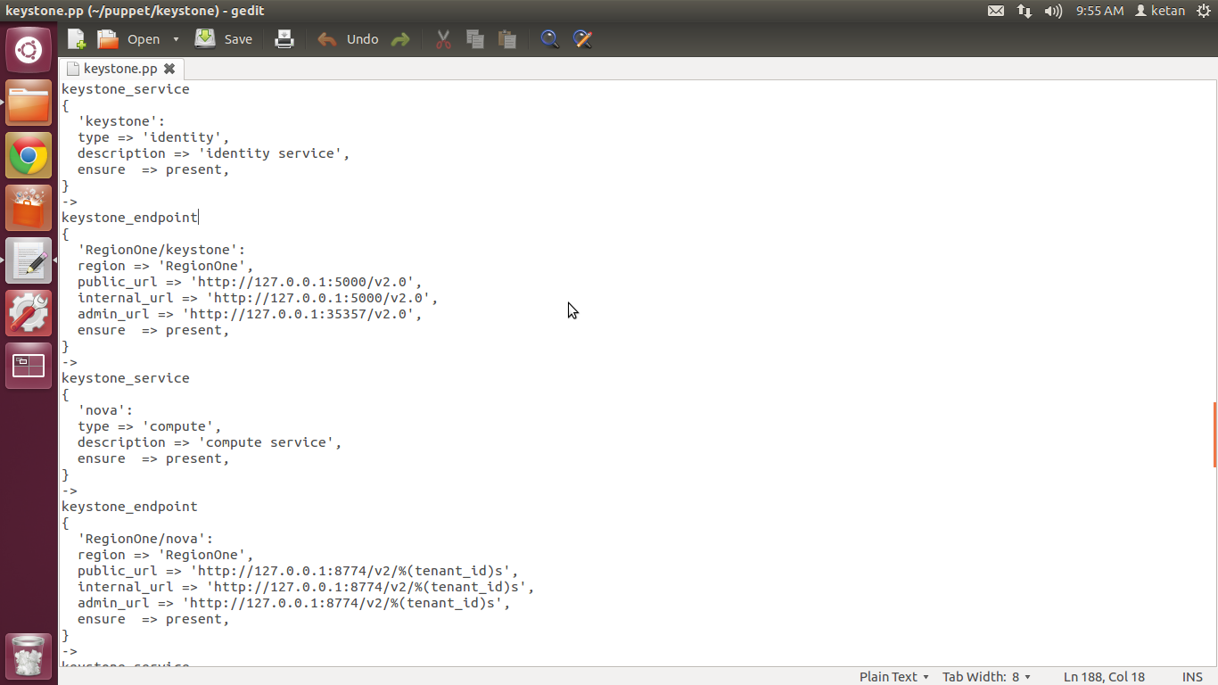

Slide 26
User Interface
Web based Graphical User Interface
AngularJS
Restlet/Jersey framework
Apache Tomcat 7

Slide 27
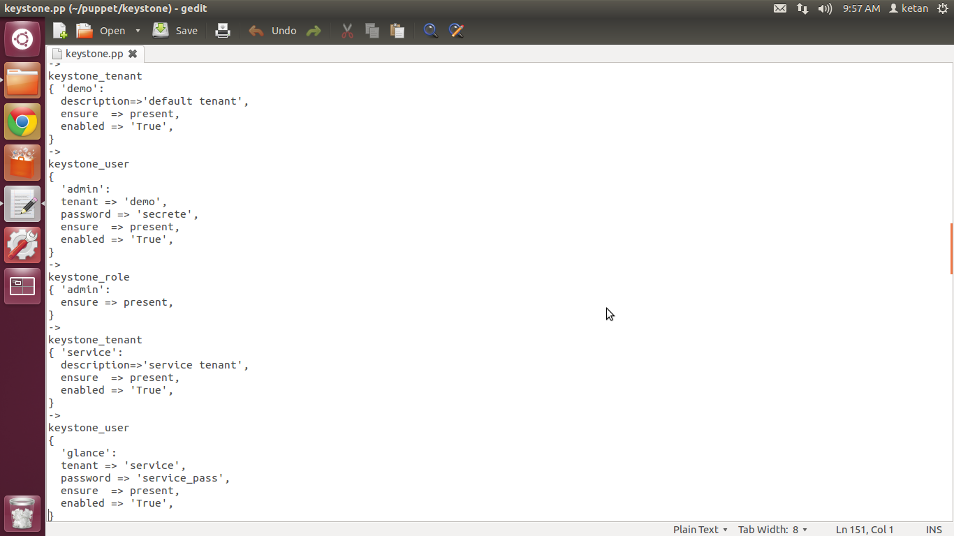

Slide 28
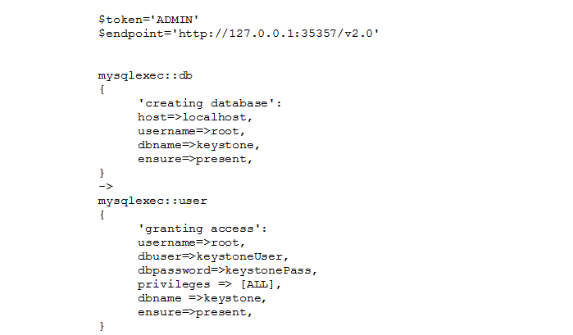

Slide 29
Literature Survey
iSCSI
Internet Small Computer System Interface.
IP-based storage networking standard for linking data storage facilities.
Used to transmit data over intranets, LANs, WANs, internet.
libvirt
Tool for managing platform virtualization.
It can be used to manage Linux KVM, Xen,VMware ESX, QEMU.
The most popular command line interface is 'virsh'.

Slide 30
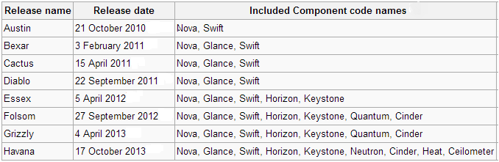
Literature Survey
Openstack Releases

